Slide 1
Clustering by Passing Messages Between Data Points
汇报人：尹卓
邮箱：michaelyin777@outlook.com

Slide 2
目录
1. 简介
2. 算法流程
3. 试验
4. 结论

Slide 3
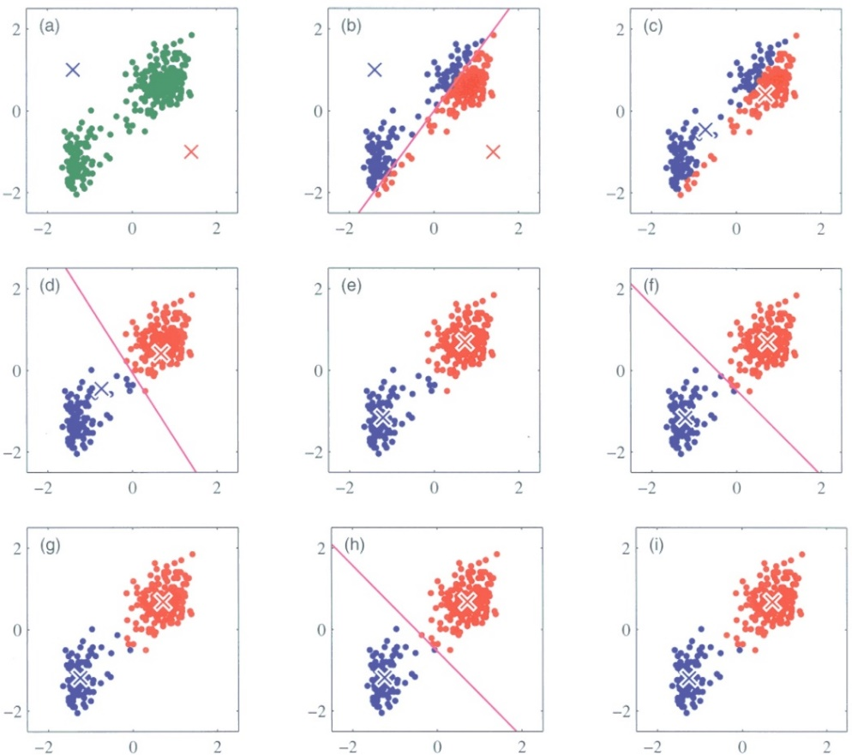
Introduction
聚类:根据点与点之间的距离（相似性）来聚类数据。
代表点:聚类的中心点，是实际的数据点。
常用的方法: k-centers clustering.
缺点：对初始值非常敏感，影响聚类效果。

Slide 4
Introduction
在k-centers聚类算法中，聚类数目事先给定。
如何让聚类算法自己确定聚类的个数，并进行聚类？
[1] Frey B J, Dueck D. Clustering by passing messages between data points[J]. science, 2007, 315(5814): 972-976.
新的聚类算法: Affinity Propagation。
将每一个样本点看做网络中的节点，并且每一个点都认为是潜在的聚类代表点。

Slide 5
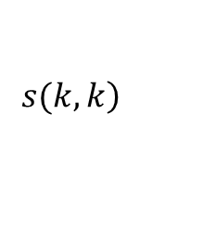
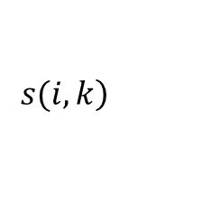
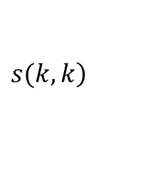
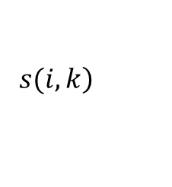
Similarity and Preference
AP聚类算法初始需要两种信息：
Similarities between data points:
Preferences:
Similarity 代表样本点k 做样本点i的代表的合适程度。
Preference 大小影响聚类的数目。
$$\left.s(i,k\right)$$
$$\left.s(k,k\right)$$
$$\left.s(i,k\right)$$
$\left.s(k,k\right)$

Slide 6
Messages exchanged
Affinity propagation 沿着网络里的边，迭代的传递实数值的信息，直到有一系列的代表点（聚类中心）的产生。
传递的有两种信息:
Responsibility
Availability
Availabilities和Responsibilities 矩阵的值结合起来，可以判断样本点属于哪一个聚类。

Slide 7
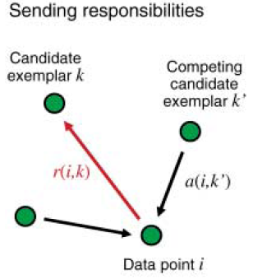

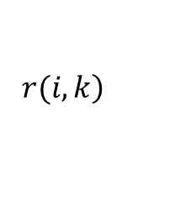

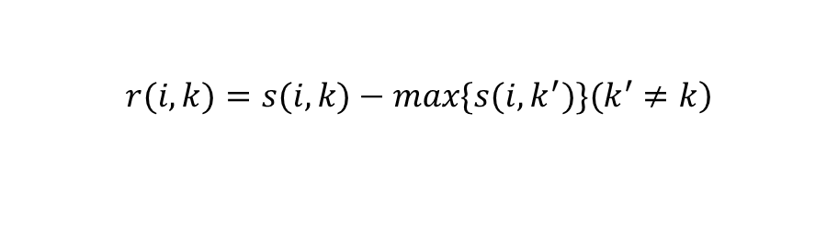
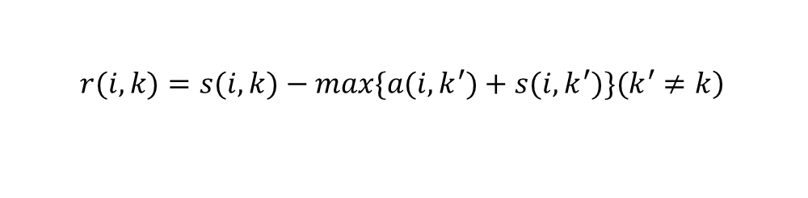
Responsibility and availability
Responsibility :反映的是k作为i的代表的合适程度的累积证据。
$$\left.r(i,k\right)$$
Availabilities 初始化为0, ,代表每一个样本点还未决定被哪一个代表点代表。
Responsibilities按如下方式更新:
如果 变大, 比k’更加适合当i
的代表点。
$$a(i,k)=0$$
$$\left.r(i,k)=s(i,k)−max\{s(i,k^{′})\}(k^{′}≠k\right)$$
$$\left.r(i,k)=s(i,k)−max\{a(i,k^{′})+s(i, k^{′})\}(k^{′}≠k\right)$$
$$r(i,k)$$

Slide 8
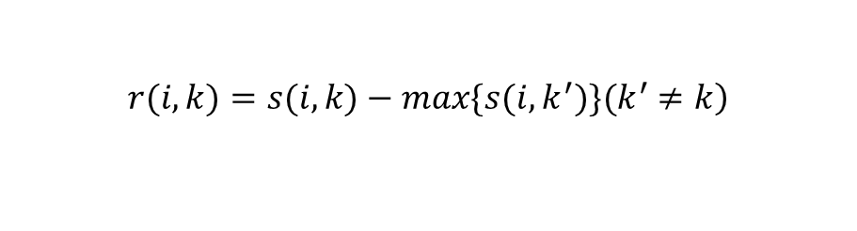
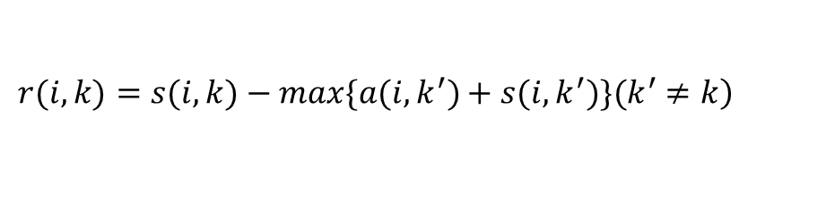
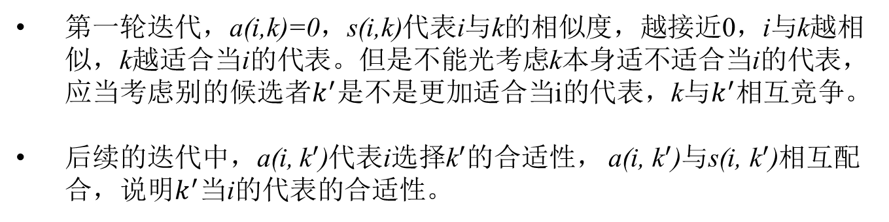

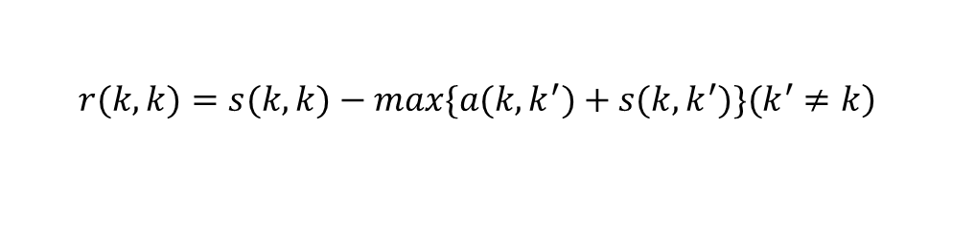
How to send message?
$$\left.r(i,k)=s(i,k)−max\{s(i,k^{′})\}(k^{′}≠k\right)$$
(For the first iteration.)
$$\left.r(i,k)=s(i,k)−max\{a(i,k^{′})+s(i, k^{′})\}(k^{′}≠k\right)$$
第一轮迭代，a(i,k)=0，s(i,k)代表i与k的相似度，越接近0，i与k越相似，k越适合当i的代表。但是不能光考虑k本身适不适合当i的代表，应当考虑别的候选者$k^{′}$是不是更加适合当i的代表，k与$k^{′}$相互竞争。
后续的迭代中，a(i, ${\text{k}}^{′}$)代表i选择${\text{k}}^{′}$的合适性， a(i, ${\text{k}}^{′}$)与s(i, ${\text{k}}^{′}$)相互配合，说明$k^{′}$当i的代表的合适性。
$$\left.r(k,k)=s(k,k)−max\{a(k,k^{′})+s(k,k^{′})\}(k^{′}≠k\right)$$
k自己代表自己的能力。 ，则说明k更加适合当从属点，而不是代表点，这点可以从迭代公式里看出来。
$$r\left(k,k\right)≤0$$

Slide 9
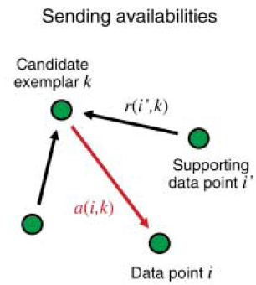
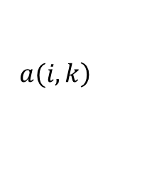
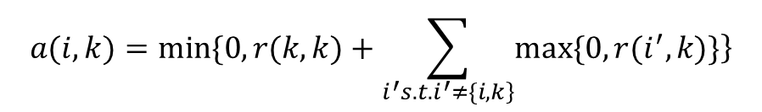
Responsibility and availability
Availability : 反映i选择k作为其代表的合适程度的累积证据。
$$\left.a(i,k\right)$$
$$a(i,k)=min\{0,r(k,k)+\sum_{\left.i^{′}s.t.i^{′}≠\{i,k\right\}}{\left.max\{0,r(i^{′},k)\}\right\}}$$

Slide 10
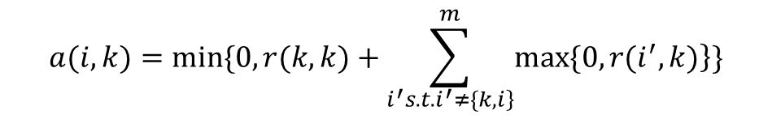
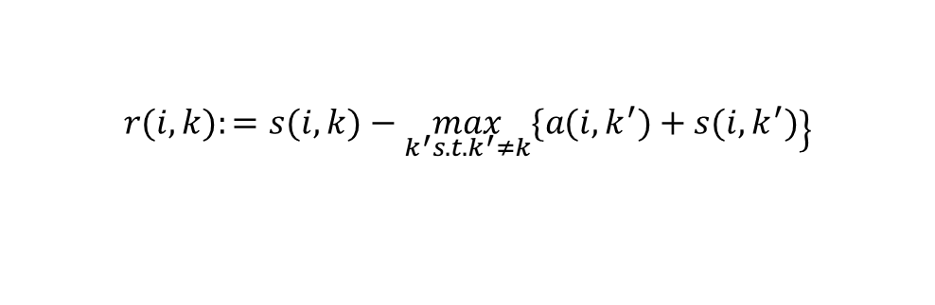
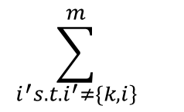
How to send message?
Availabilities由下面式子更新:
$$a(i,k)=min\{0,r(k,k)+\sum_{\left.i^{′}s.t.i^{′}≠\{k,i\right\}}^{m}{\left.max\{0,r(i^{′},k)\right\}\}}$$
$$\sum_{\left.i^{′}s.t.i^{′}≠\{k,i\right\}}^{m}{}$$
除了i以外的点的点i’， 证明k是适合当代表点的。
k点自己证明自己能当代表点 + 除了i以外的点证明k适合当代表点 = i选择k做代表有底气。
若Availability小于0,将会增加其他点的Responsibility:
availability <0
$$\left.r(i,k):=s(i,k)−\max_{k^{′}s.t.k^{′}≠k}\{a(i,k^{′})+s(i,k^{′})\right\}$$

Slide 11

How to identify the cluster?
对于点i, 我们可以计算:
若 k = i, 则i就是一个代表点。否则，最大的k的列坐标，就是i点的代表点。
$$\max_{k} a\left(i,k\right)+r\left(i,k\right)$$

Slide 12
Method Description
Each iteration of affinity propagation consisted of:
Updating all responsibilities given the availabilities.
Updating all availabilities given the responsibilities.
Combining responsibilities and availabilities to monitor the exemplar decisions.
When does the algorithm terminate?

Slide 13
Method Description
The procedure may be terminated:
after a fixed number of iterations.
after changes in the messages fall below a threshold.
after the local decisions stay constant for some number of iterations.

Slide 14
Experiments

Slide 16
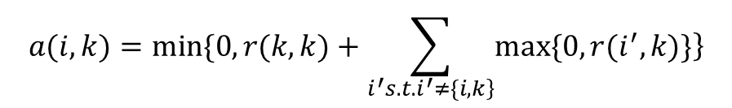
Responsibility and availability
Availability : 反映i选择k作为其代表的合适程度的累积证据。
$$\left.a(i,k\right)$$
$$a(i,k)=min\{0,r(k,k)+\sum_{\left.i^{′}s.t.i^{′}≠\{i,k\right\}}{\left.max\{0,r(i^{′},k)\}\right\}}$$

Slide 17
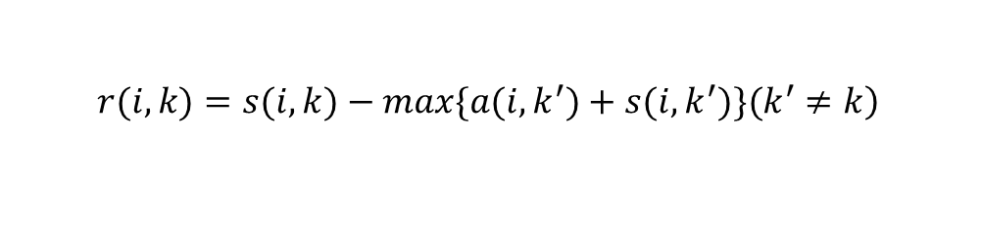

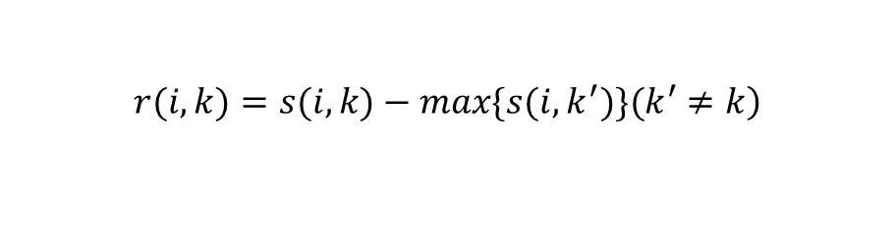
How to send message?
The availabilities are initialized to 0, , it means each point doesn’t decide which exemplar it belongs to.
The responsibilities are updated by:
If r is bigger, it means the point k is more well-suited for point i than other exemplars k’.
$$a(i,k)=0$$
$$\left.r(i,k)=s(i,k)−max\{s(i,k^{′})\}(k^{′}≠k\right)$$
(For the first iteration.)
$$\left.r(i,k)=s(i,k)−max\{a(i,k^{′})+s(i, k^{′})\}(k^{′}≠k\right)$$

Slide 18
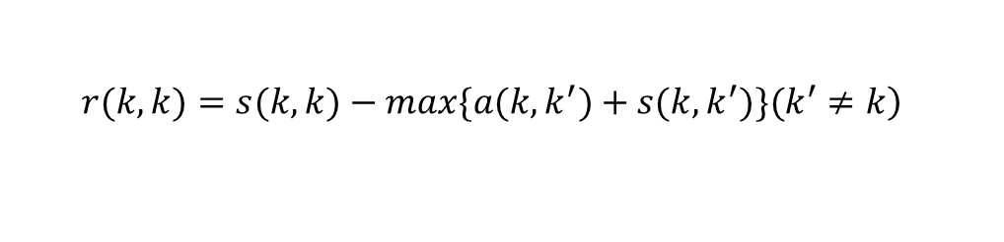
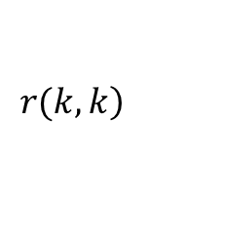

How to send message?
Self-responsibility : for i = k, it will be
How appropriate it would be for data point k as an exemplar itself?
If , exemplar is more appropriate to belong to other exemplars.
$$\left.r(k,k\right)$$
$$\left.r(k,k)=s(k,k)−max\{a(k,k^{′})+s(k,k^{′})\}(k^{′}≠k\right)$$
$$r\left(k,k\right)≤0$$

Slide 19
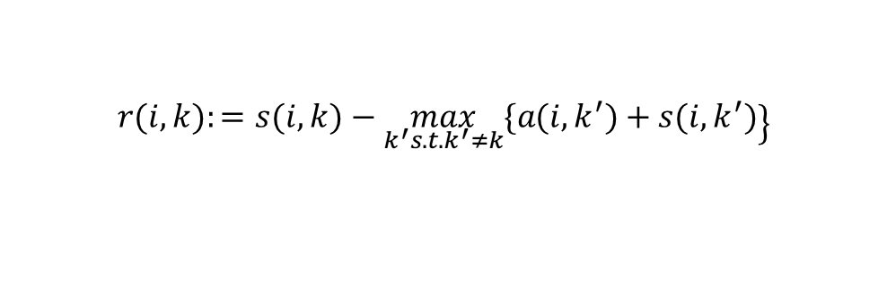
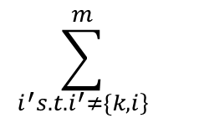
How to send message?
The availabilities are updated by:
$$a(i,k)=min\{0,r(k,k)+\sum_{\left.i^{′}s.t.i^{′}≠\{k,i\right\}}^{m}{\left.max\{0,r(i^{′},k)\right\}\}}$$
It’s the sum of responsibilities for supporting points i’ to exemplar k.
If a = 0, it means exemplar point k is more well-suited to point i.
$$\sum_{\left.i^{′}s.t.i^{′}≠\{k,i\right\}}^{m}{}$$
If availability is less than 0, it will increase the other points’ responsibility:
availability <0
$$\left.r(i,k):=s(i,k)−\max_{k^{′}s.t.k^{′}≠k}\{a(i,k^{′})+s(i,k^{′})\right\}$$
Responsibility from data point i to exemplar k increases!

Slide 20
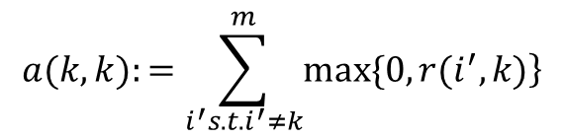
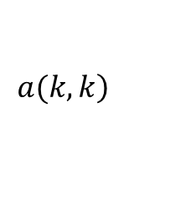
How to send message?
Self-availability : for i = k, it will be
$$\left.a(k,k\right)$$
$$a(k,k):=\sum_{i^{′}s.t.i^{′}≠k}^{m}{\left.max\{0,r(i^{′},k)\right\}}$$
How appropriate it would be for data point k as an exemplar itself? Based on the responsibilities from other data points i.

Slide 21
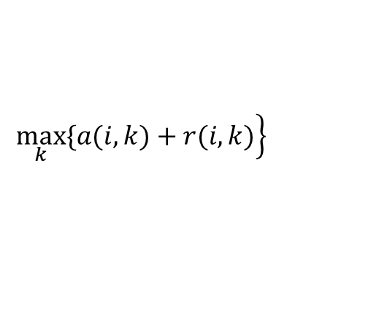
How to identify the cluster?
For point i, we would like to find:
If k = i, the data point i is an exemplar itself.
Otherwise, the data point k is the exemplar of point i.
$$\left.\max_{k}\{a(i,k)+r(i,k)\right\}$$

Slide 22
Method Description
Each iteration of affinity propagation consisted of:
Updating all responsibilities given the availabilities.
Updating all availabilities given the responsibilities.
Combining responsibilities and availabilities to monitor the exemplar decisions.
When does the algorithm terminate?

Slide 23
Method Description
The procedure may be terminated:
after a fixed number of iterations.
after changes in the messages fall below a threshold.
after the local decisions stay constant for some number of iterations.

Slide 24
Experiments

